Slide 1
PROJECT PARTNER PRESENTATION
SUTRA - Municipality of Caorle
Enzo Lazzarin
2ᵑᵈ Steering Committe (SC) meeting - GORIZIA, 12 July 2019

Slide 2
50 projects were approved with the program INTERREG V-A Italt-Croatia
AXIS 1 – Strengthening innovation in
blue economy
8 projects
AXIS 2 – Safety end resilence
10 projects
AXIS 3 – Environmental and cultural heritage
22 projects
AXIS 4 – Marittime transport
10 projects
Notes:
22 projects

Slide 3
Caorle adheres to the design intervention with 9 partners:
PP1 - Municipality of Chioggia (Italy)
PP2 - Municipality of Ravenna (Italy)
PP3 - Intermunicipalities Territorial Union Bassa Friulana (Italy)
PP4 - Municipality of Pescara (Italy)
PP5 - Institute of International Sociology of Gorizia (Italy)
PP6 - Split and Dalmatia County (Croatia)
PP7 - Town of Porec-Parenzo (Croatia)
PP8 - Municipality of Vodnjan _Dignano (Croatia)
PP9 - City of Slit (Croatia)

Slide 4
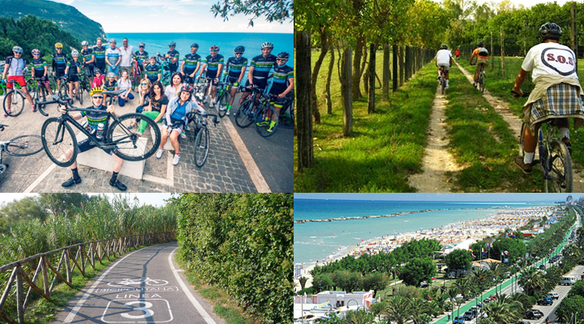
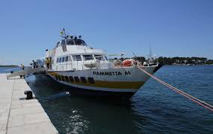
SUTRA
Sustainable Transport in adriatic coastal areas and hinterland”
SUTRA (LP Municipality of Caorle) is promoting passenger multimodality in the Programme Area through the joint design of sustainable urban mobility concepts and new crossborder links by implementing actions aimed at enhancing the use of alternative means of transport that better connects the coast with its hinterland
Notes:
Investimento € 2.897.730
Investimento € 2.897.730

Slide 5
SUTRA
Sustainable Transport in Adriatic Coastal Areas and Hinterland
General investment € 2.897.730,00
Investment for the Municipality of Caorle € 495.000,00
Notes:
Investimento € 2.897.730
Investimento € 2.897.730

Slide 6
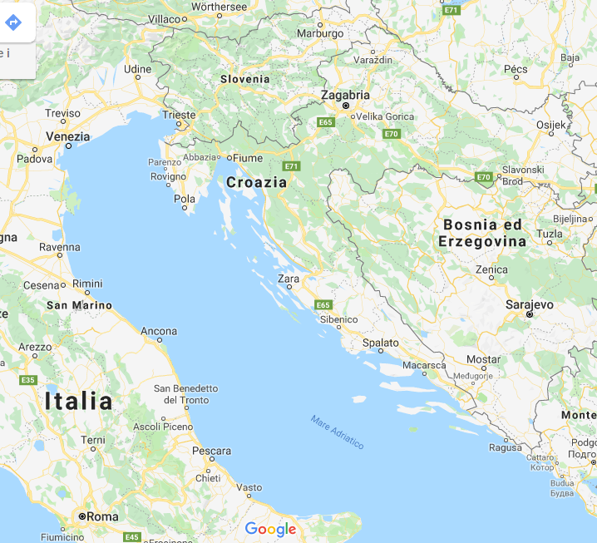
LP– CITTA’ DI CAORLE
MARITIME CONNECTION
CAORLE- PARENZO
Notes:
PP9 – CITY OF SLIT

Slide 7
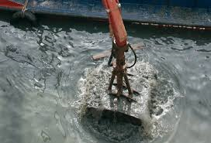
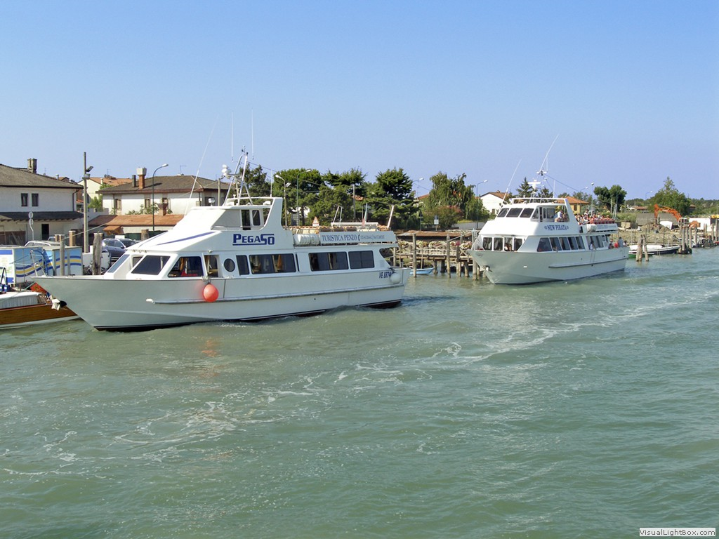
PROCUREMENT CODE
LP – CITTA’ DI CAORLE
Excavation of the bottom of the canals
Caorle-Poreč maritime connection
Notes:
PP9 – CITY OF SLIT

Slide 8
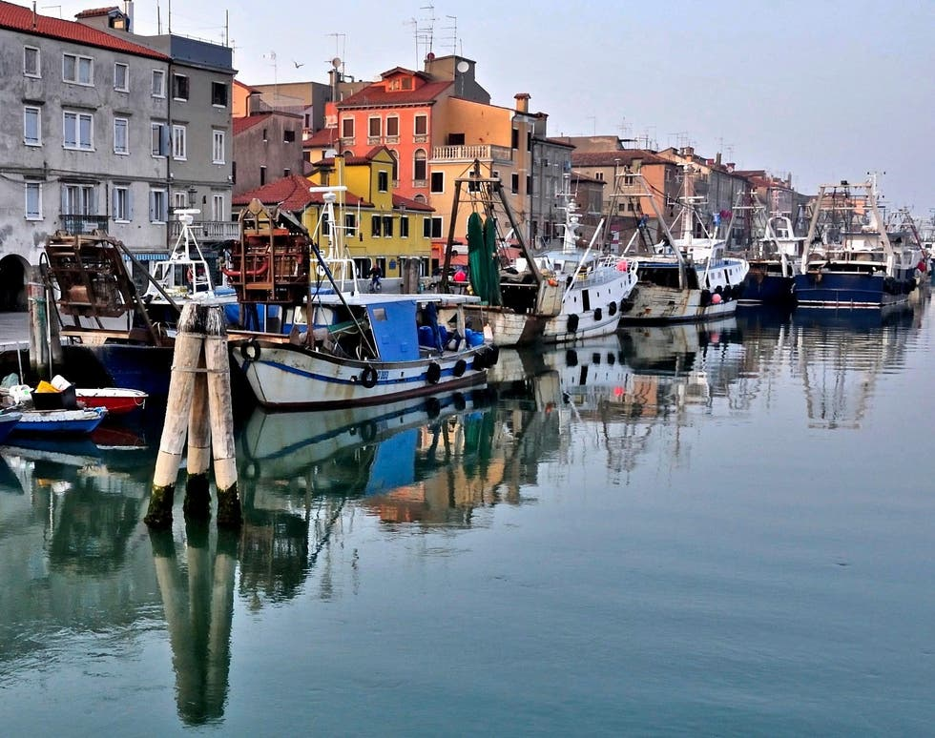
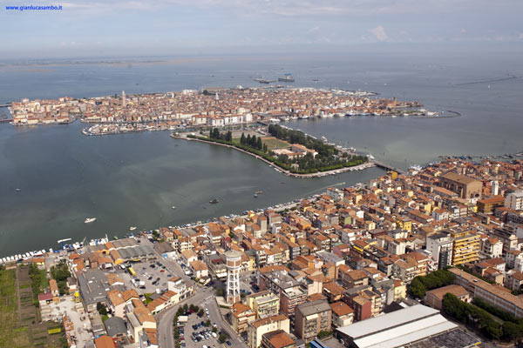
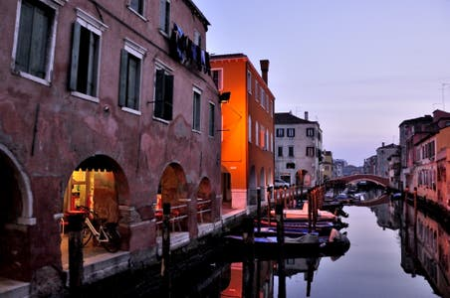
PP1 – CITTA’ DI CHIOGGIA
1 - SYSTEM OF .. TO CONNECT DIFFERENT POINTS OF INETEREST OF THE CITY AND THE BEACH
2 – MARITIME CONNECTION FROM CHIOGGIA TO THE CROATIAN COAST
Notes:
2 – COLLEGAMENTO MARITTIMO DA CHIOGGIA ALLA COSTA CROATA

Slide 9
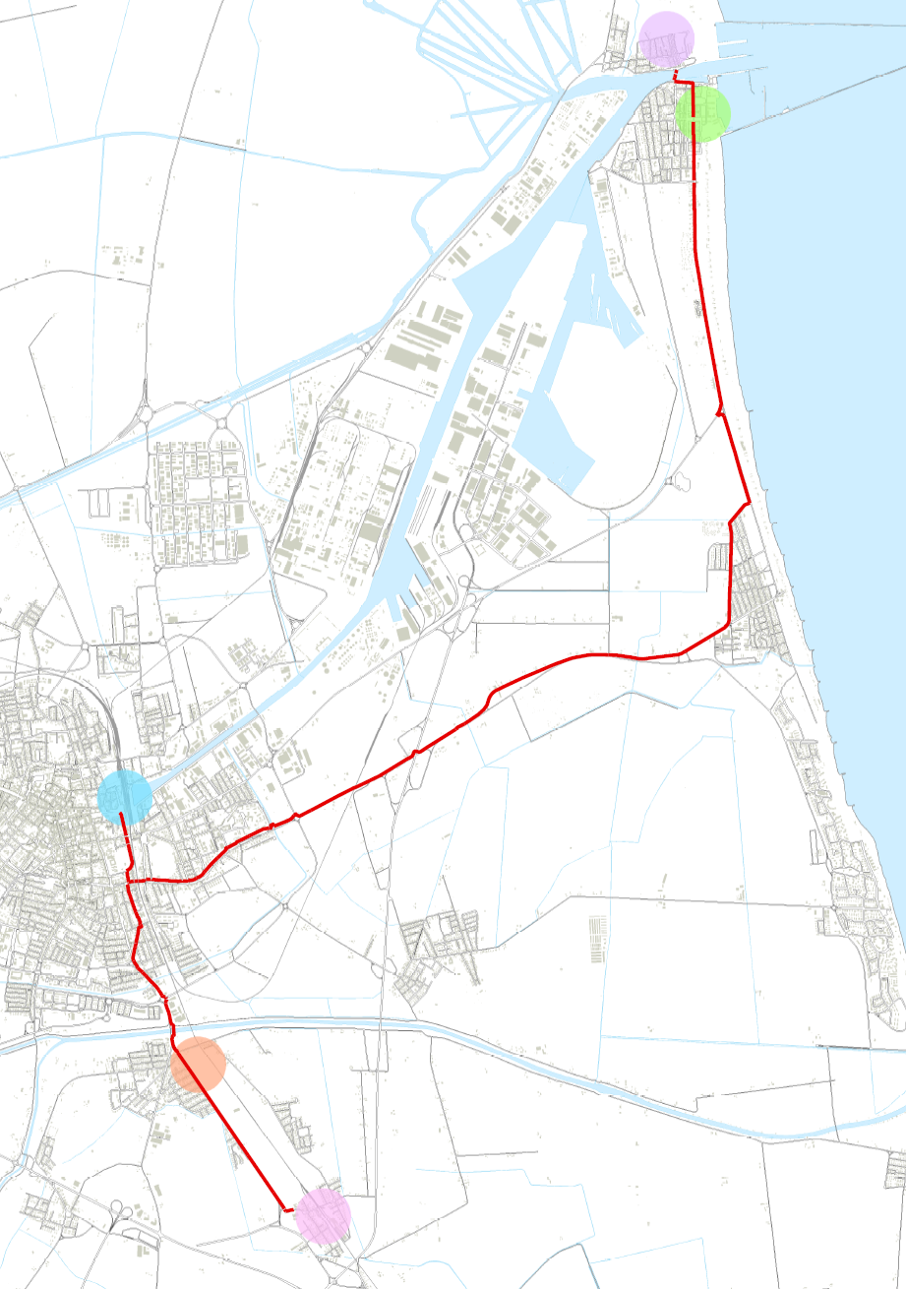
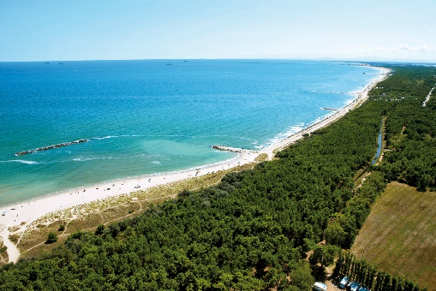
PP2 CITTA’ DI RAVENNA
INTEGRATED SUSTAINABLE TRANSPORT SYSTEM THAT EXTENDS FROM THE CENTER OF THE CITY TO THE OUTSKIRTS AND THE PORT

Slide 10
PP3 – INTERMUNICIPALITIES TERRITORIAL UNION BASSA FRIULANA
SUMMARY OF THE PROJECT:
The main objective of the project is to implement the number of users of cycle paths through the promotion of cycle-river park, the creation of interchange micro-hubs, through the installation of an electric bike-sharing station in the Municipalities of Lignano Sabbiadoro, Palazzolo dello Stella and Precenicco. Value added to the project is given by the possibility of traveling in one way or return the auction of the Stella river and the Lagoon of Marano e Degree with an electric boat of about 12 seats, non-polluting and substantially silent, respectful of the delicate environment river and lagoon.
ACTIONS WITH RELIEF ON THE TERRITORY OF THE UTI RIVIERA BASSA FRIULANA
The structures which are projected to be built consist in three different e-bike sharing hubs providing top-up service settled in the Municipalities of Lignano Sabbiadoro, Palazzolo dello Stella and Precenicco. Will be also purchased 24 assisted bicycles, settling in the three sites, and an electric boat of about 12 seats. Each starting point will be equipped of wi-fi. It’s going to be assess the possibility of setting up a collection service and transport of bicycles from one municipality to another.
Notes:
PP3 – UTI RIVIERA BASSA FRIULANA

Slide 11
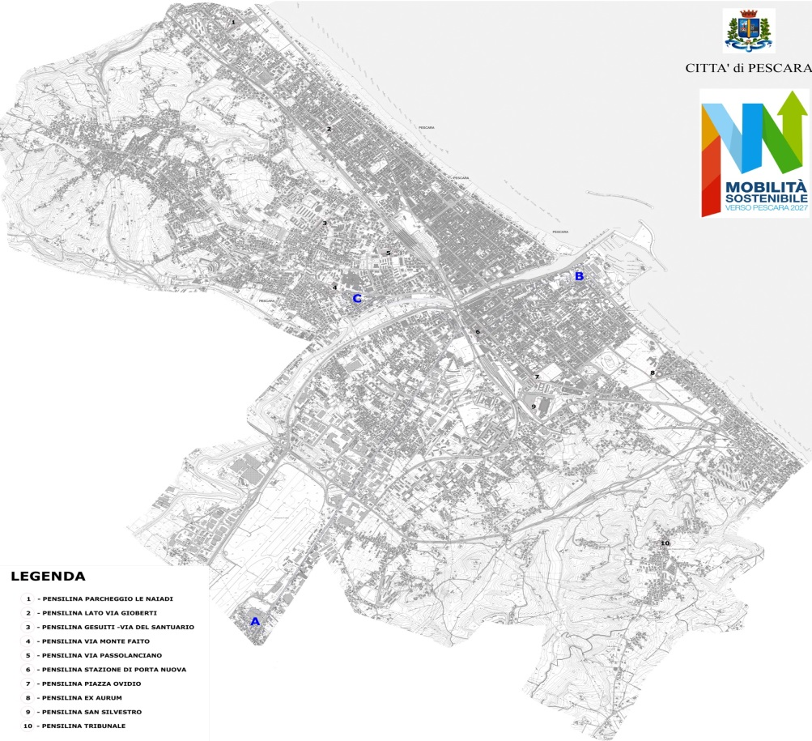
General and specific strategic objectives
PP4 – MUNICIPALITY OF PESCARA
PERFORMANCE EFFICIENCY FUNCTIONAL
Realization of the trolleybus system;
Improvement of modal traffic distribution;
Congestion reduction;
Development of cycling and pedestrian mobility;
Development of the metropolitan use of the railway;
Improvement of urban logistics.
QUALITY IMPROVEMENT ENVIRONMENT
Reduction of air pollution;
Reduction of noise pollution;
Differentiated traffic and mobility moderation;
Creation of areas with environmental priority.
INCREASE OF THE SOCIAL VALUE OF SERVICE
Improvement of accessibility to public transport;
Increased road safety;
Improvement of user satisfaction;
Improving social inclusion.
- Promote integrated policies to address the complexity of transport systems;
- Focus transport mobility planning on citizens' needs;
- Non-polluting urban transport.
Notes:
PP6 -

Slide 12
PP5 – ISIG – INSTITUTE OF INTERNATIONAL SOCIOLOGY OF GORIZIA
Communication strategy
WP Communication aims at ensuring the communication, dissemination and visibility of the project’s objectives, activities and results outside the partnership and towards the target groups/relevant stakeholders.
General public
Local, regional and national public authorities
Enterprises, transport operators including operators of multimodal logistics hubs, infrastructure providers
Regional development agencies
Addresses all aspects of the project communications
Outlines target groups of the project communication
Describes communication tools and channels to be adopted
Prepared by LP and Split Dalmatia county
Approved by all partners (Steering Committee
Notes:
PP5 – ISIG – INSTITUTE OF INTERNATIONAL SOCIOLOGY OF GORIZIA

Slide 13
PP6 – SPLIT AND DALMATIA COUNTRY
Outputs and deliverables
2.1 Start up activities
2.1.1 Kick off meeting
2.1.2 Communication strategy
2.1.3 Lists an maps of low costs/free of charge channels, relevant metworks and stakeholders (1 for each PP)
2.3 Digital activities
2.3.1 Project website
2.3.2 Sections for SUTRA project hosted on PPs website
2.3.3 Social media profiles (Facebook, Instagram and Twitter
2.2 Media relations and publications
2.2.1 Collection of articles
2.2.2 Press releases (1 Ko Meeting + 6 Press Conferences during 6 SCs + mid-term &
final cross-border event)
2.2.3 Project posters
2.2.4 Project flyer
2.2.5 Publications on relevant EU paper magazines
2.4 Events
2.4.1 High leve mid-term (PP6 in Split) & closing (LP in Caorle) cross-border event
2.4.2 Participation on EU level events
2.4.3 Press conferences
2.4.4 Trainings (web platform, communication and implementation)
2.4.5 Local public events for the inauguration of the multimodal transport services
Notes:
PP6 –

Slide 14
Improvement of existing local transport
through multimodal services
PP7 – TOWN OF POREC
Analysis of end users need regarding local multimodal mobility Organize 1 meeting with authorities and transport providers, 1 with local residents to gather data for the CB analysis outlining critical points and solutions. Definition of joint crossborder multimodal strategy for urban centres nominate 1 person from own staff that will participate in at least 2 ad hoc meetings where the strategy will be discussed.
Improvement of multimodal smart services for soft mobility: new low carbon mobility service, established through an electrical vehicle (electrical minibus), connecting city centre with the hinterland for the benefit of residents and tourists
Continuous monitoring and evaluation of the implemented system, gather data on the number of passenger using the innovative means of transport through built/in IT-management systems and other means, in the last months of the project, organize focus groups with local population and authorities to assess the utility and quality of the pilot actions by administering ad hoc questionnaires share and distribute through own institutional networks the created Manual of proposals for improvement and transfer to other areas.
Notes:
PP6 – TOWN OF POREC - PARENZO

Slide 15
PP9 – CITY OF SPLIT
Improvement of existing local transport trough multimodal services
Analysis of end users need regarding local multimodal mobility;
Definition of joint crossborder multimodal strategy for urban centres;
Improvement of multimodal smart services for soft mobility
Implementation of pilot actions for new multimodal links
Public bike sharing system
Evaluation of pilot actions and proposals for improvement and sustainability
Development of smart phone app for easy access to multimodal transport
Mobile app for Google Play and Apple Store
Notes:
PP9 – CITY OF SLIT

Slide 16
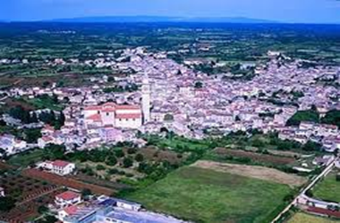
PP8 – MUNICIPALITY OF VODNJAN
Project activity aim:
- redirect the tourist flow from the coast to the hinterland
- promote new sustainable form of tourism ( cultural, religious, eno-gastro)
- overcome seasonality in tourism
- purchase (vehicle) and establish a new multimodal connection with sea localities during tourism season
Notes:
PP8 – MUNICIPALITY OF VODNJAN DIGNANO

Slide 17
THE MUNICIPAL ADMINISTRATION
OF CAORLE IS
LEADER PARTNER
Thank you for your attention
Enzo Lazzarin
Notes:
enzo lazzarin

Slide 18
Municipality – Caorle (Ve)
Organization name contact person: Leader Partner Ing. Enzo Lazzarin
Address: Municipality – Caorle (Ve) – Italy - Via Roma, 26
Email: enzo_lazzarin@comune.caorle.ve.it - PEC: comune.caorle.ve@pecveneto.it
Telephone number: 0421.219225
www.italy-croatia.eu/SUTRA
Notes:
Municipality – Caorle (Ve)

