Slide 1

Pilot actions for Adrigreen airports and ports
Adrigreen online meeting
16 February 2021

Slide 2

Introduction
The environmental analysis outlined that the environmental footprint of the Adrigreen airports and ports could be reduced (thus improved) by applying actions regarding:
Water consumption,
Waste management,
Energy consumption,
Carbon footprint regarding the activities listed above,
Sustainable transportation of passengers from/to the airport/port infrastructures.
For water and energy consumption, the performances of Adrigreen ports and airports are compared with the data calculated for the other Adrigreen partners and presented in terms of CO2 emissions and budget. In fact, we considered useful to highlight the possible greenhouse gas abatements and the possible economic benefits of in terms of budget reduction.

Slide 3
Introduction – Status table
Most of the proposed actions are summarized in tables, each row outlining the following information:
general action,
specific short-term/long term action,
metrics,
status,
Fit among Strengths/Weaknesses of each Adrigreen airport/port
Fit among Opportunities/Threats of each Adrigreen airport/port
STATUS | DESCRIPTION
0 | NOT APPLICABLE OR NOT SUGGESTED
1 | APPLICABLE AND SUGGESTED
2 | PARTIALLY IMPLEMENTED
3 | IMPLEMENTED

Slide 4
Introduction – Evaluation tables - Strengths/Weaknesses
STRENGTHS/WEAKNESSES INDEX | DESCRIPTION
-2 | The implementation of the specific action is expected to have minor or negative influence on the Strengths whilst boosting several Weaknesses of the airport/port.
-1 | The implementation of the specific action is expected to have minor or none influence on the Strengths whilst boosting one or more Weaknesses of the airport/port.
0 | The implementation of the specific action is expected either not to interact with Strengths and Weaknesses of the airport/port or to balance the related effects
1 | The implementation of the specific action is expected to boost one or more Strengths whilst having minor/no influence on the Weaknesses of the airport/port.
2 | The implementation of the specific action is expected to boost several Strengths whilst having minor or positive influence on the Weaknesses of the airport/port.

Slide 5
Introduction – Evaluation tables - Opportunities/Threats
OPPORTUNITIES/THREATS INDEX | DESCRIPTION
-2 | The implementation of the specific action is expected to have minor or negative influence on the Opportunities whilst boosting several Threats of the airport/port.
-1 | The implementation of the specific action is expected to have minor or none influence on the Opportunities whilst boosting one or more Threats of the airport/port.
0 | The implementation of the specific action is expected either not to interact with Opportunities and Threats of the airport/port or to balance the related effects
1 | The implementation of the specific action is expected to boost one or more Opportunities whilst having minor/no influence on the Threats of the airport/port.
2 | The implementation of the specific action is expected to boost several Opportunities whilst having minor or positive influence on the Threats of the airport/port.

Slide 6
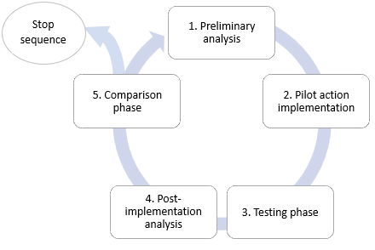
Introduction-Steps for the pilot actions
The structure of the report is:
Pilot actions for Adrigreen airports
Pilot actions for Adrigreen ports
Sustainable solutions for the transport of passengers from/to airport/port infrastructures
Annex: an example of the environmental analysis related to greenhouse gases and airborne pollutants emissions of a specific action.

Slide 7
Pilot actions for Adrigreen airports

Slide 8
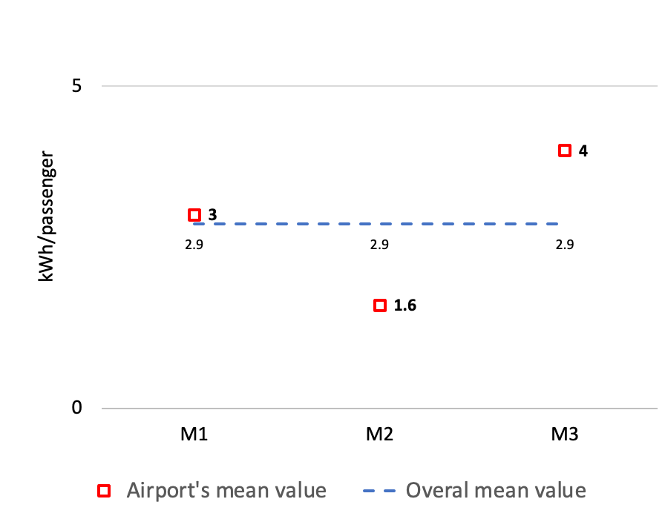
Airports’ calculation:
Consumption Benchmarking example
To picture the difference between airports’ OVERALL mean consumption and the single Adrigreen airport benchmarks, the differences were expressed in terms of GHG emissions and budget
Airports | Consumption in 2016 [kWh/pass] | Consumption in 2017 [kWh/pass] | Consumption in 2018 [kWh/pass] | Airport’s mean consumption [kWh/pass] | Airports’ overall mean consumption [kWh/pass]
M1 | 2.9 | 3 | 3.1 | 3
M2 | 1.5 | 1.6 | 1.7 | 1.6
M3 | 3.9 | 4 | 4.1 | 4
 |  |  |  |  | 2.9
 | Color legend
Data
Calculated
Airports | Airport’s mean consumption above/below the overall mean [kWh/passenger]
M1 | 0.1
M2 | -1.3
M3 | 1.1

Slide 9
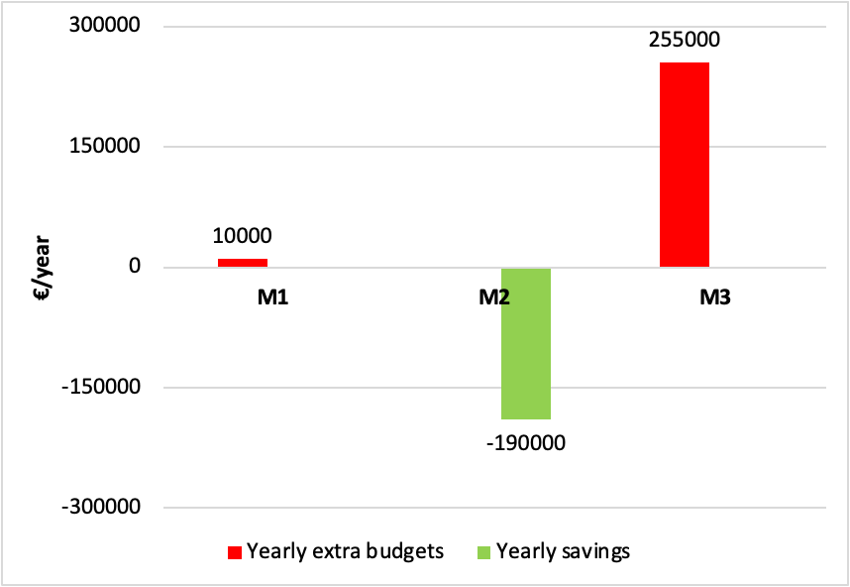
Airports’ calculation: Example of savings/extra budgets
Airports | Airport’s mean consumption above/below the overall mean [kWh/passenger] | Average number of passengers/ year between 2016-2018 [number of passenger] | Airport’s mean consumption above/below the overall mean [kWh]
M1 | 0.1 | 300000 | 40000
M2 | -1.3 | 600000 | -760000
M3 | 1.1 | 900000 | 1020000
Airports | Airport’s mean consumption above/below the overall mean [kWh] | Airports’ overall mean cost [€/kWh] | Savings/extra budgets [€/year]
M1 | 40000 |  | 10000
M2 | -760000 |  | -190000
M3 | 1020000 |  | 255000
 |  | 0.25
 | Color legend
Data
Calculated

Slide 10
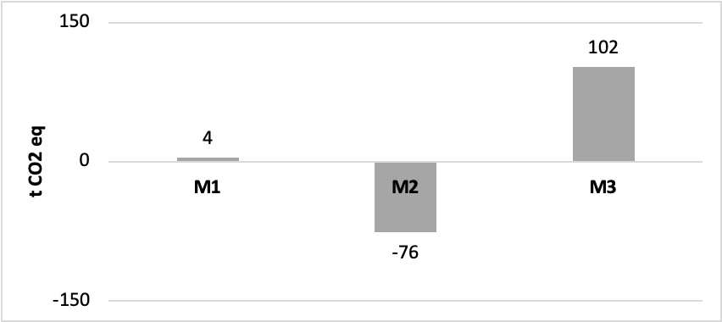
Airports’ calculation: Example for variations in GHG
Airports | Airport’s mean consumption above/below the overall mean [kWh] | Emission factor [g CO2e/kWh] | Savings/extra GHG emissions [t CO2 eq]
M1 | 40000 |  | 4
M2 | -760000 |  | -76
M3 | 1020000 |  | 102
 |  | 100
 | Color legend
Data
Calculated

Slide 11
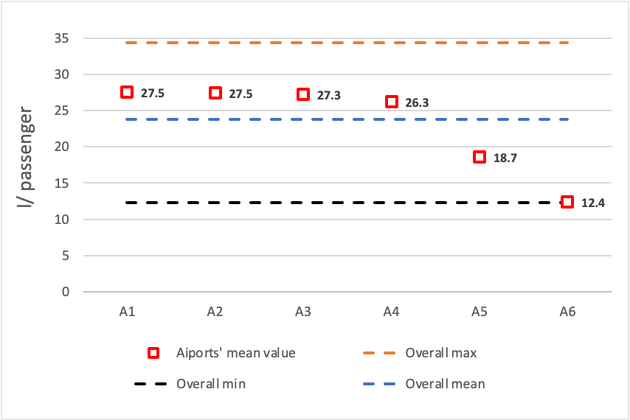
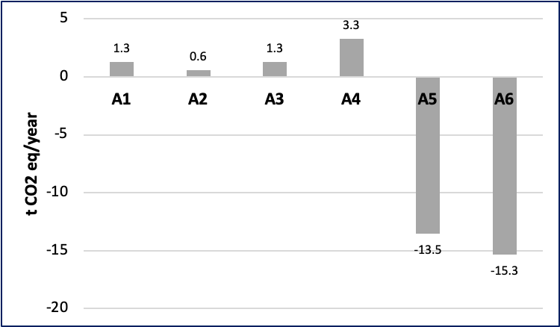
Airports’ water management: Differences in GHG emissions
Airports’ mean water consumption and overall maximum, minimum and mean water consumption per passenger in the time period 2016–2018.
Leakages, incidents, and flushing in regard of fresh water supply were not considered.
Differences in GHG emissions deriving from the difference between airports' yearly mean and overall mean water consumption in the time period 2016 – 2018.

Slide 12
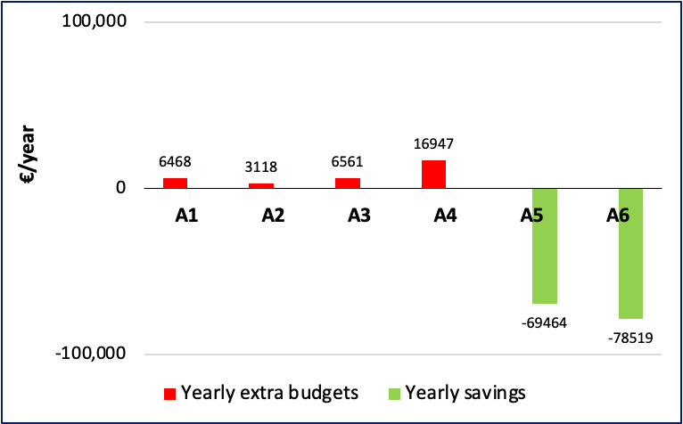
Airports’ water management: Yearly savings/extra budgets
Yearly savings/extra budgets deriving from water consumption below/above the Adrigreen airports’ average based on Adrigreen airports’ overall mean cost of water (3.0 €/m3) in the time period 2016–2018.

Slide 13
Airports’ water management: Example of actions
General action | Specific Short-Term Long-Term Action | Metrics | Applicable to | Status | Strengths Weaknesses (Index) | Opportunities Threats (Index)
Decreasing water consumption | Monitoring of water consumption (STA). | Water consumption (m3, l/pass) | A1 | 2 | 1 | 1
 |  |  | A2 | 2 | 1 | -1
 |  |  | A3 | 2 | 1 | 0
 |  |  | A4 | 2 | N/A | N/A
 |  |  | A5 | 2 | 1 | 1
 |  |  | A6 | 2 | 2 | 1
Decreasing water consumption | Rainwater harvest and use (LTA). | Water consumption (m3, l/pass) | A1 | 1 | 2 | 1
 |  |  | A2 | 1 | 1 | -1
 |  |  | A3 | 1 | 1 | 0
 |  |  | A4 | 1 | N/A | N/A
 |  |  | A5 | 3 | N/A | N/A
 |  |  | A6 | 3 | N/A | N/A

Slide 14
Airports’ water management: Examples of case studies
General action | Specific action | Metrics | Airport reference case studies
Decreasing water consumption | Monitoring for water consumption and leaks | Water consumption (m3, l/pass) | Manchester Airport, London Heathrow International Airport (De Castro Carvalho et al. 2013)
Decreasing water consumption | Rainwater harvest and use | Water consumption (m3, l/pass). | A5, and A6 airports (this study); Boston Logan International Airport (Massport 2018); Website of Delhi Airport (2021);
Reduce the water footprint | Organize training and education of airport staff | Participants’ satisfaction. | Website of Airports International Council

Slide 15
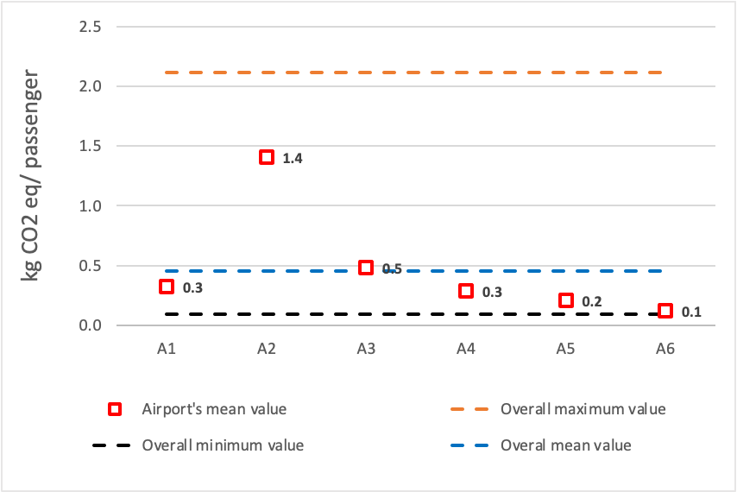
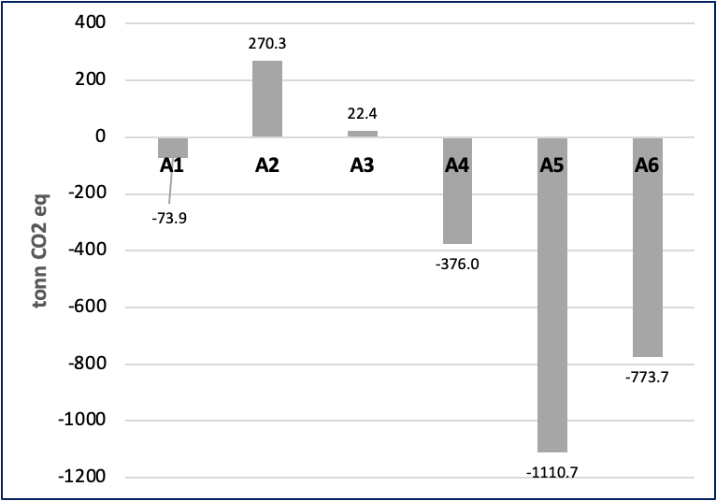
Airports’ fuel consumption for heating buildings: Differences in GHG emissions
Airports’ mean GHG emissions and overall maximum, minimum and mean GHG emission values deriving from the fuel used for heating buildings per passenger in the time period 2016–2018.
Variations in GHG emissions related to the difference between airports' yearly mean and overall mean fuel consumption for heating buildings in the time period 2016–2018.

Slide 16
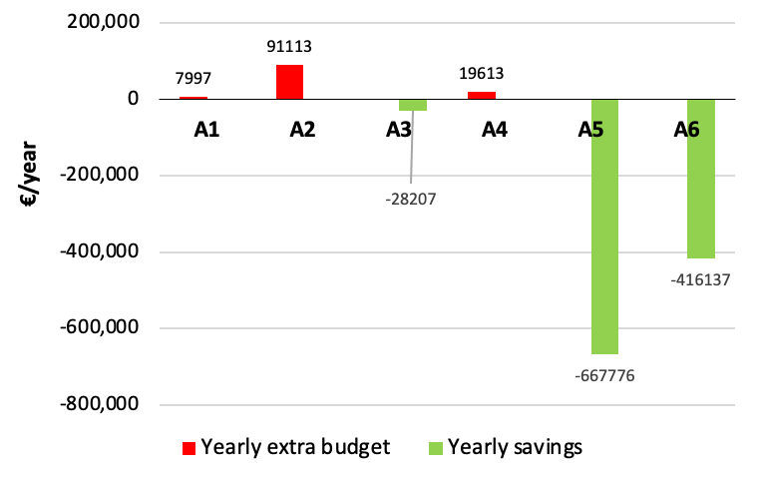
Airports’ fuel consumption for heating buildings:
Yearly savings/extra budgets
Variations in budgets related to differences between airports’ yearly mean and the overall mean fuel consumption for heating buildings based on the Adrigreen airports’ overall mean cost of diesel fuel (1.1 €/l), heating oil (0.6 €/l), and natural gas (0.64 €/m3) in the time period 2016–2018.

Slide 17
Airports’ fuel consumption for heating buildings:
Example of actions
General action | Specific Short-Term Long-Term Action | Metrics | Applicable to | Status | Strengths Weaknesses (Index) | Opportunities Threats (Index)
Decreasing energy consumption | Building Management System (STA). | Total energy consumed; electricity consumption (kWh/year); fuel consumption (m3- l- kg- /year) GHG emissions (kg CO2eq./m3 kg CO2eq./pass) | A1 | 1 | 1 | 1
 |  |  | A2 | 1 | 2 | 1
 |  |  | A3 | 3 | N/A | N/A
 |  |  | A4 | 1 | N/A | N/A
 |  |  | A5 | 1 | 0 | 1
 |  |  | A6 | 1 | 1 | 0

Slide 18
Airports’ fuel consumption for heating buildings:
Example of case studies
General measure | Specific measure | Metrics | Airport reference case studies
Decreasing energy consumption | Building management system. | Total energy consumed (electricity consumption (kWh); fuel consumption (m3; l; kg)) GHG emissions (kg CO2 eq/m3; kg CO2 eq/passenger) | A3 airport (this study);
Decreasing energy consumption | Cogeneration plant. | Total energy consumed (electricity consumption (kWh); fuel consumption (m3; l; kg)) GHG emissions (kg CO2 eq/m3; kg CO2 eq/passenger) | Website of Leonardo da Vinci Airport (—). Malpensa Airport (SEA energia. 2019)

Slide 19
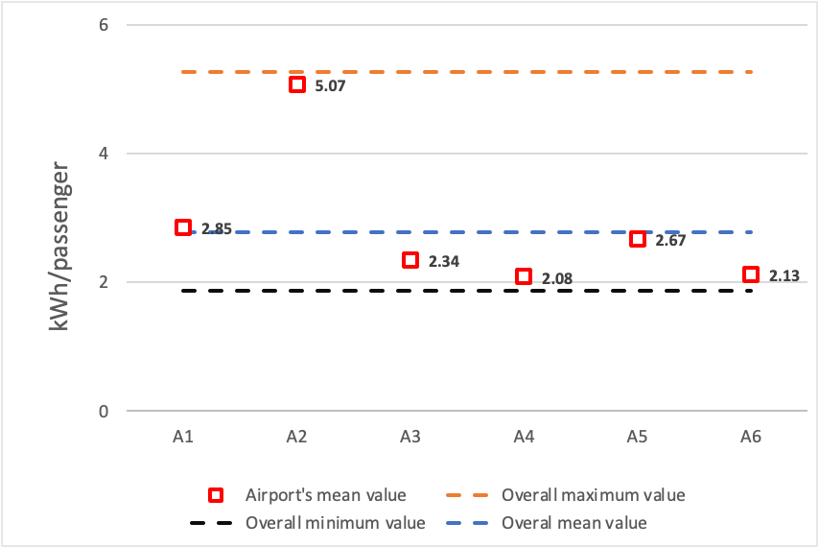
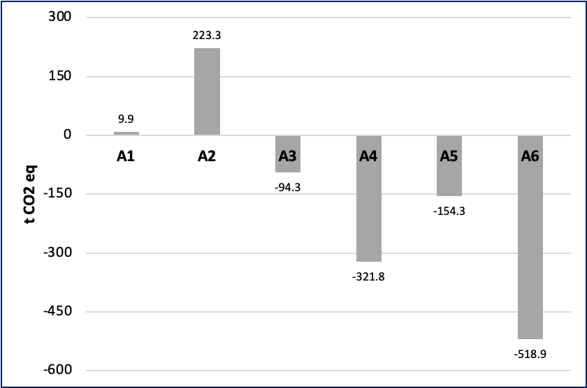
Airports’ electricity consumption: Differences in GHG emissions
Airports’ mean electricity consumption and overall maximum, minimum and mean electricity consumption values per passenger in the time period 2016–2018.
Departures in GHG emissions related to the difference between airports' yearly mean and overall mean electricity consumption in the time period 2016 – 2018.

Slide 20
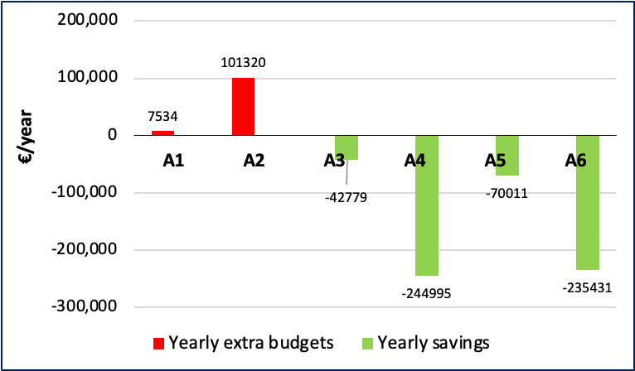
Airports’ electricity consumption: Yearly savings/extra budgets
Yearly savings/extra costs deriving from electricity consumption below/above the Adrigreen airports’ consumption benchmark based on Adrigreen airports’ overall mean price (0.15 €/kWh) in the time period 2016–2018.

Slide 21
Airports’ electricity consumption: Example of actions
General action | Specific Short-Term Long-Term Action | Metrics | Applicable to | Status | Strengths Weaknesses (Index) | Opportunities Threats (Index)
Decreasing electricity consumption | Light-Emitting Diodes (LED) lightning (STA). | Electricity consumption (kWh); GHG emissions (CO2eq.) | A1 | 2 | 0 | 1
 |  |  | A2 | 2 | 1 | 1
 |  |  | A3 | 2 | 1 | 0
 |  |  | A4 | 2 | N/A | N/A
 |  |  | A5 | 2 | 0 | 1
 |  |  | A6 | 2 | -1 | 1
Decarbonizing electricity consumption | Solar energy to power aircrafts at the gate (LTA). | Electricity consumption (kWh) vs fuel consumption (l); GHG emissions and airborne pollutants emissions | A1 | 1 | 2 | 0
 |  |  | A2 | 1 | 1 | 1
 |  |  | A3 | 1 | 1 | 1
 |  |  | A4 | 1 | N/A | N/A
 |  |  | A5 | 1 | 0 | 2
 |  |  | A6 | 1 | 2 | 0

Slide 22
Airports’ electricity consumption: Example of case studies
General action | Specific action | Metrics | Airport reference case studies
Decreasing electricity consumption | Light-emitting diodes (LED) lightning. | Electricity consumption (kWh); GHG emissions (CO2eq.). | Copenhagen Airport (Baxter, et al. 2018)
Decarbonizing electricity consumption | Solar energy to power aircrafts at the gate. | Electricity consumption (kWh) vs fuel consumption (l); GHG emissions (CO2eq.) and airborne pollutants emissions. | Douala International Airport (ICAO —d)
Decarbonizing electricity consumption | Purchase of electricity generated from a mix of renewable energy sources. | GHG emissions (CO2eq.); Amount of renewable energy purchased by the airport, as a percentage of total energy consumed by the airport (ACI 2012). | A5, and A6 airports (this study)

Slide 23
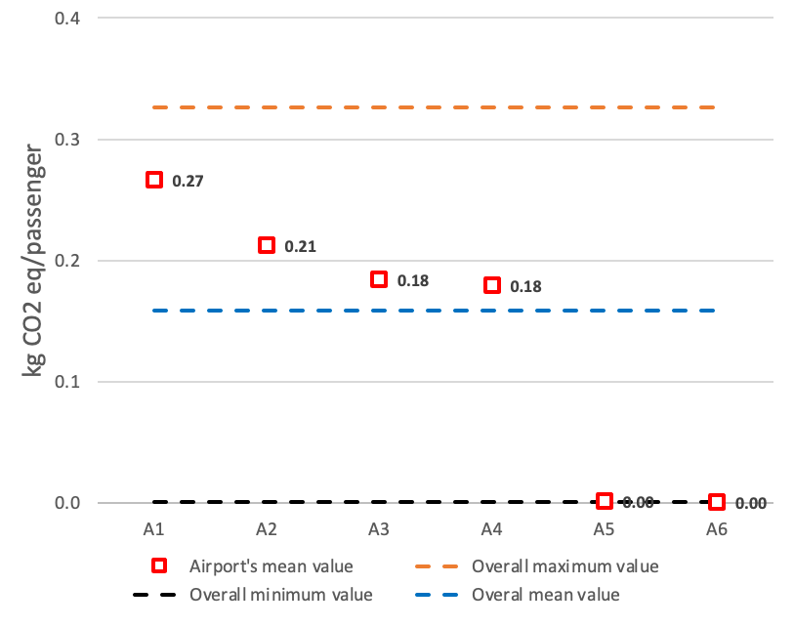
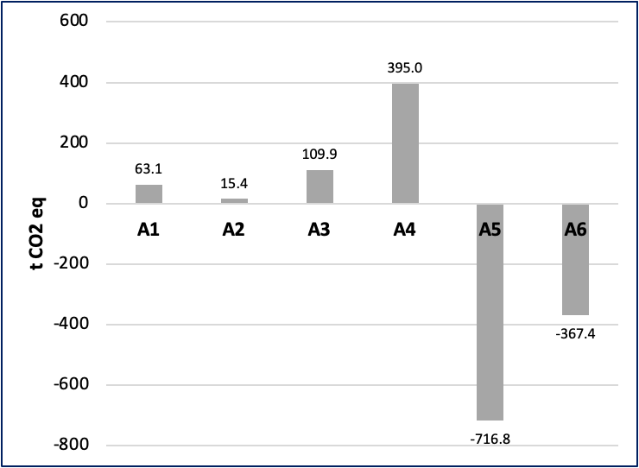
Airports’ fossil fuel consumption of company operated vehicles: Differences in GHG emissions
Airports’ mean GHG emissions and overall maximum, minimum and mean GHG emission values deriving from (company operated vehicles) fossil fuel consumption per passenger in the time period 2016–2018.
Variations in GHG emissions related to the difference between airports' yearly mean and overall mean fuel consumption for company operated vehicles in the time period 2016 –2018.

Slide 24
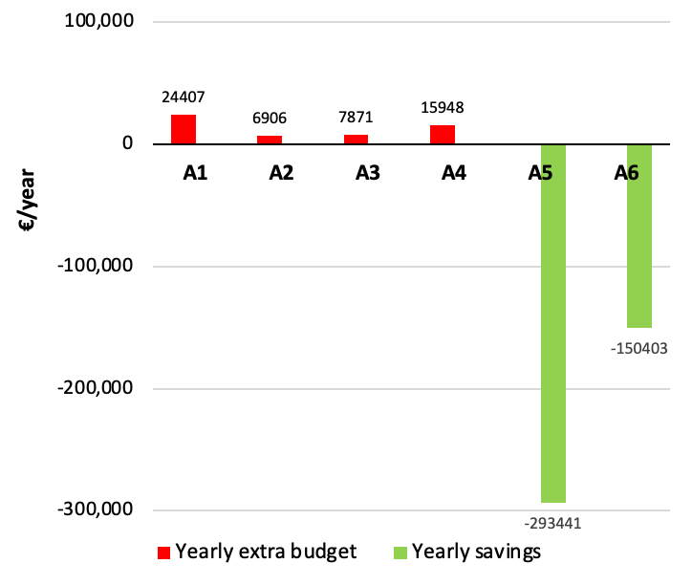
Airports’ fossil fuel consumption of company operated vehicles: Yearly savings/extra budgets
Variations in budgets related to differences between airports’ yearly mean and the overall mean fuel (diesel and petrol) consumption for company operated vehicles based on the Adrigreen airports’ overall mean cost of diesel (1.12 €/l), and petrol (1.23 €/l) in the time period 2016–2018.

Slide 25
Airports’ fossil fuel consumption of company operated vehicles: Example of actions
General action | Specific Short-Term Long-Term Action | Metrics | Applicable to | Status | Strengths Weaknesses (Index) | Opportunities Threats (Index)
Decreasing fossil fuel consumption | Purchase of electric vehicles (e.g., electric aircraft tug, electric baggage tractor, etc.) (STA). | Electricity consumption (kWh) versus kg or l fossil fuel; GHG emissions (CO2eq.) | A1 | 2 | 0 | 1
 |  |  | A2 | 1 | 1 | 1
 |  |  | A3 | 2 | 2 | 2
 |  |  | A4 | 2 | N/A | N/A
 |  |  | A5 | 1 | 0 | 2
 |  |  | A6 | 1 | -1 | 0
Decreasing fossil fuel consumption | Anti-idling communication campaign (STA) | GHG and airborne pollutants emissions | A1 | 1 | 1 | 1
 |  |  | A2 | 1 | 2 | 2
 |  |  | A3 | 1 | 1 | 0
 |  |  | A4 | 1 | N/A | N/A
 |  |  | A5 | 1 | 2 | 1
 |  |  | A6 | 1 | 2 | 1

Slide 26
Airports’ fossil fuel consumption of company operated vehicles: Example of case studies
General action | Specific action | Metrics | Airport reference case studies
Decreasing fossil fuel consumption | Purchase of electric vehicles (e.g., electric aircraft tug, electric baggage tractor, etc.) | Electricity consumption (kWh) versus kg or l of fossil fuel; GHG emissions (CO2eq.) | Copenhagen Airport (2018)
Decreasing fossil fuel consumption | Provide charging stations for electric vehicles | Electricity consumption (kW); GHG and airborne pollutants emissions | A1 airport (this study); Helsinki Airport (Finavia 2019).
Decreasing fossil fuel consumption | Anti-idling communication campaign | GHG and airborne pollutants emissions | Copenhagen Airport (2018)
Decarbonizing fuel consumption | Use of alternative renewable fuels (diesel from waste and residue) for diesel vehicles. | Consumption of renewable fuel vs fossil fuel (l); GHG emissions (CO2eq.) | Helsinki Airport, and other Lapland Airports (Finavia 2018)

Slide 27
Airports’ waste management: example of initiatives
General action | Specific Short-Term Long-Term Action | Metrics | Applicable to | Status | Strengths Weaknesses (Index) | Opportunities Threats (Index)
Waste prevention | Disposable plastic cutlery and beverages replaced with easily degradable materials (STA) | kg plastic waste/passenger. | A1 | 3 | N/A | N/A
 |  |  | A2 | 1 | 0 | 1
 |  |  | A3 | 1 | 0 | 1
 |  |  | A4 | 1 | N/A | N/A
 |  |  | A5 | 1 | 1 | 2
 |  |  | A6 | 1 | 2 | 1
Promoting waste reuse | Use of environmentally friendly asphalt for repaving parking lots and runways (LTA) | tons of recycled asphalt; emissions of GHG and airborne pollutants. | A1 | 1 | 1 | 0
 |  |  | A2 | 1 | 2 | 0
 |  |  | A3 | 1 | 2 | 0
 |  |  | A4 | 1 | N/A | N/A
 |  |  | A5 | 1 | 2 | 2
 |  |  | A6 | 1 | 2 | 1

Slide 28
Airports’ waste management: example of case studies
General action | Specific action | Metrics | Airport reference case studies
Promoting waste prevention and recycling | Economic incentives for recycling more and generating less waste (e.g., the pay-as-you-throw program) | tons of waste fractions/year. | London Stansted Airport (2010)
Waste prevention | Disposable plastic cutlery and beverages replaced with easily degradable materials | kg plastic waste/passenger. | A1 airport (this study); Glasgow Airport (2019)
Promoting waste recycling | Training of employees on recycling. | tons of waste fractions/year; participants’ satisfaction. | A5, and A6 airports (this study); London Stansted Airport (2010). Website of Airports International Council
Promoting waste reuse | Use of environmentally friendly asphalt for repaving parking lots and runways | tons of recycled asphalt; emissions of GHG and airborne pollutants | Hamburg, Frankfurt, Munich, and Cambridge Airports, (D’Angelo et al. 2008, White 2013); Logan International Airport (Civil + Structural Engineer, 2008)

Slide 29
Pilot actions for Adrigreen ports

Slide 30
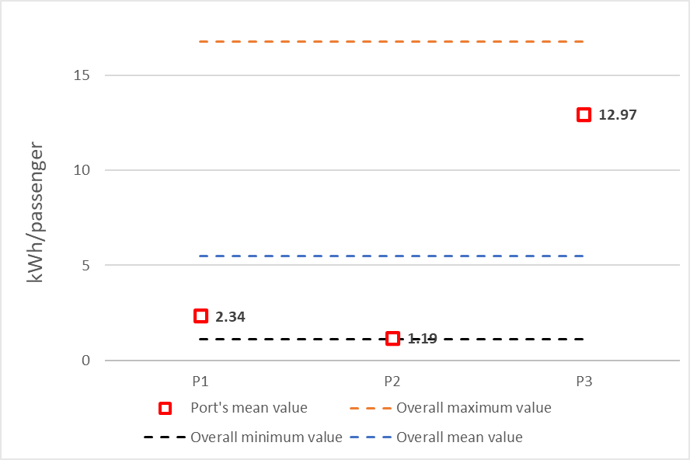
Port’s energy management – GHG balance
Ports’ mean energy consumption and overall maximum, minimum and mean energy consumption values per passenger in the time period 2016–2018.
Variations in GHG emissions related to the difference between ports' yearly mean and overall mean electricity consumption in the time period 2016 – 2018.

Slide 31
Port’s energy management – Yearly savings/extra budgets
a)
Yearly savings/extra budgets deriving from electricity consumption below/above the Adrigreen ports’ consumption benchmark based on Adrigreen ports’ specific minimum cost (a); mean cost (b); maximum cost (c) in the time period 2016-2018.

Slide 32
Port’s energy management – Initiatives
General action | Specific Short-Term Long-Term Action | Metrics | Applicable to | Status | Strengths Weaknesses (Index) | Opportunities Threats (Index)
Decreasing electricity consumption | Light-emitting diodes (LED) lightning (STA). | Electricity consumption (kWh); GHG emissions (CO2eq.) | P1 | 1 | 1 | 0
 |  |  | P2 | 3 | N/A | N/A
 |  |  | P3 | 1 | 2 | 1
Decreasing electricity consumption | Energy monitoring system (STA). | Electricity consumption (kWh); GHG emissions (CO2eq.) | P1 | 2 | 1 | 1
 |  |  | P2 | 2 | 2 | 2
 |  |  | P3 | 2 | 2 | 1
Decarbonizing electricity consumption | Photovoltaic or solar panel (STA). | Electricity consumption (kWh); GHG emissions (CO2eq.) | P1 | 1 | 1 | 1
 |  |  | P2 | 1 | 2 | 2
 |  |  | P3 | 1 | 2 | 1
Decreasing electricity consumption | Passive house concept and eco-building standards (LTA). | Electricity consumption (kWh); GHG emissions (CO2eq.) | P1 | 1 | 2 | 0
 |  |  | P2 | 1 | 2 | 0
 |  |  | P3 | 1 | 2 | 0

Slide 33
Port’s energy management – Initiatives
General action | Specific Short-Term Long-Term Action | Metrics | Applicable to | Status | Strengths Weaknesses (Index) | Opportunities Threats (Index)
Decreasing electricity consumption | Light-emitting diodes (LED) lightning (STA). | Electricity consumption (kWh); GHG emissions (CO2eq.) | P1 | 1 | 1 | 0
Decarbonizing electricity consumption | Geothermal energy plant for heating and cooling (LTA) | Electricity consumption (kWh) from commercial grid; GHG emissions (CO2eq.) | P1 | 1 | 2 | 1
 |  |  | P2 | 2 | 2 | 2
 |  |  | P3 | 1 | 2 | 0
Decarbonizing electricity consumption | Purchase of electricity generated from a mix of renewable energy sources (STA). | GHG emissions (CO2eq.); Amount of renewable energy purchased by the port, as a percentage of total energy consumed. | P1 | 1 | 1 | 0
 |  |  | P2 | 1 | 1 | 1
 |  |  | P3 | 1 | 1 | 0
Decarbonizing electricity consumption | Wave energy converters (LTA). | Electricity consumption (kWh) from commercial grid; GHG emissions (CO2eq.) | P1 | 1 | 1 | 1
 |  |  | P2 | 1 | 2 | 2
 |  |  | P3 | 1 | 2 | 0

Slide 34
Port’s energy management – Case studies
General action | Specific Short-Term Long-Term Action | Metrics | Port reference case studies
Decreasing electricity consumption | Light-emitting diodes (LED) lightning (STA). | Electricity consumption (kWh); GHG emissions (CO2eq.) | P2 port (this study) Website port of Bilbao Website port of Amsterdam Website port of Tyne Website port of Venice
Decreasing electricity consumption | Energy monitoring system (STA). | Electricity consumption (kWh); GHG emissions (CO2eq.) | Website port of Koper Website JadeWeser Port Website port of Valencia
Decarbonizing electricity consumption | Photovoltaic or solar panel (STA). | Electricity consumption (kWh); GHG emissions (CO2eq.) | Website port of Rotterdam Website port of Antwerp Website port of Gothenburg

Slide 35
Port’s energy management – Case studies
General action | Specific Short-Term Long-Term Action | Metrics | Port reference case studies
Decreasing electricity consumption | Passive house concept and eco-building standards (STA). | Electricity consumption (kWh); GHG emissions (CO2eq.) | Website port of Amsterdam Website port of Aalborg
Decarbonizing electricity consumption | Geothermal energy plant for heating and cooling (LTA) | Electricity consumption (kWh) from the commercial grid; GHG emissions (CO2eq.) | Website port of Marseille
Decarbonizing electricity consumption | Purchase of electricity generated from a mix of renewable energy sources (short-term measure). | GHG emissions (CO2eq.); Amount of renewable energy purchased by the port, as a percentage of total energy consumed. | Website port of Vancouver
Decarbonizing electricity consumption | Wave energy converters (long-term measure). | Electricity consumption (kWh) from the commercial grid; GHG emissions (CO2eq.) | Port of Ostende

Slide 36
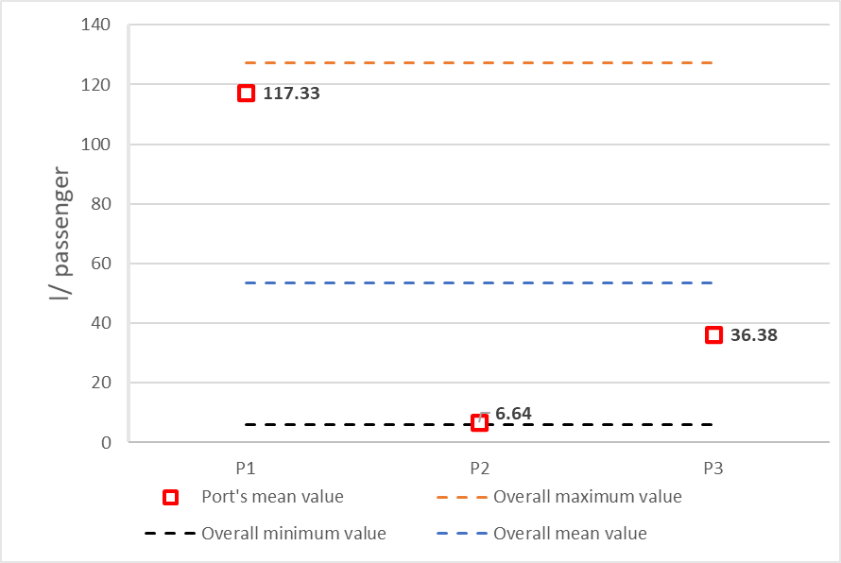
Port’s water management – GHG balance
Ports’ mean energy consumption and overall maximum, minimum and mean water consumption values per passenger in the time period 2016–2018.
Variations in GHG emissions related to the difference between ports' yearly mean and overall mean water consumption in the time period 2016 – 2018.

Slide 37
Port’s water management –Yearly savings/extra budgets
a)
Yearly savings/extra budgets deriving from water consumption below/above the Adrigreen ports’ consumption benchmark based on Adrigreen ports’ specific minimum cost (a); mean cost (b); maximum cost (c) in the time period 2016-2018.

Slide 38
Port’s water management – Initiatives
General action | Specific Short-Term Long-Term Action | Metrics | Applicable to | Status | Strengths Weaknesses (Index) | Opportunities Threats (Index)
Decreasing water consumption | Monitoring of water consumption (STA) | Water consumption (m3, l/pass) | P1 | 2 | 1 | 1
 |  |  | P2 | 2 | 2 | 2
 |  |  | P3 | 1 | 2 | 2
Decreasing water consumption | Rainwater collection and reuse (LTA) | Water consumption (m3, l/pass) | P1 | 1 | 1 | 1
 |  |  | P2 | 3 | N/A | N/A
 |  |  | P3 | 1 | 2 | 2
Reduce the water footprint | Organize training and education of port staff (STA) | Participants’ satisfaction. | P1 | 2 | 0 | 0
 |  |  | P2 | 1 | 0 | 1
 |  |  | P3 | 1 | 1 | 1

Slide 39
Port’s water management – Initiatives
General action | Specific Short-Term Long-Term Action | Metrics | Applicable to | Status | Strengths Weaknesses (Index) | Opportunities Threats (Index)
Reduce the water pollution | Surface water and groundwater quality monitoring (STA) | Water quality criteria. | P1 | 3 | N/A | N/A
 |  |  | P2 | 3 | N/A | N/A
 |  |  | P3 | 1 | 2 | 2
Decreasing water consumption | Public/office toilettes devices (STA) | Water consumption (m3, l/pass). | P1 | 1 | 1 | 0
 |  |  | P2 | 1 | 1 | 0
 |  |  | P3 | 1 | 1 | 0
Decreasing water consumption | Ships reward system to reduce consumption (STA) | Water consumption (m3, l/pass) | P1 | 1 | 2 | 1
 |  |  | P2 | 1 | 2 | 2
 |  |  | P3 | 1 | 2 | 2
Improve water quality | Wastewater treatment plant (LTA) | GHG emissions (CO2eq.) | P1 | 1 | -1 | -1
 |  |  | P2 | 1 | -1 | 0
 |  |  | P3 | 0 | N/A | N/A

Slide 40
Port’s water management – Case studies
General action | Specific Short-Term Long-Term Action | Metrics | Port reference case studies
Decreasing water consumption | Monitoring of water consumption (short-term action). | Water consumption (m3, l/passenger) | Port of venice
Decreasing water consumption | Rainwater reuse (long-term action) | Water consumption (m3, l/passenger) | P2 port (this study)
Reduce the water footprint | Organize training and education of port staff (short-term action). | Participants’ satisfaction. | Port of Venice Website port of Rotterdam
Reduce the water footprint | Surface water and groundwater quality monitoring (short-term action). | Water quality criteria. | P1 port (this study) P2 port (this study)

Slide 41
Port’s water management – Case studies
General action | Specific Short-Term Long-Term Action | Metrics | Port reference case studies
Decreasing water consumption | Public/office toilettes devices (short-term action). | Water consumption (m3, l/passenger). | It is a very common practice but it is important to update the technology of the systems.
Decreasing water consumption | Ships reward system to reduce consumption (short-term action). | Water consumption (m3, l/passenger) | Website port of Rotterdam
Improve water quality | Wastewater treatment plant (long-term action). | GHG emissions (CO2eq.) | Port of Nantes-Saint Nazaire

Slide 42
Port’s waste management – Initiatives
General action | Specific Short-Term Long-Term Action | Metrics | Applicable to | Status | Strengths Weaknesses (Index) | Opportunities Threats (Index)
Promoting waste prevention and recycling | Economic incentives for recycling more and generating less waste (short-term action). | tons of waste fractions/year | P1 | 1 | 1 | 0
 |  |  | P2 | 1 | 1 | 0
 |  |  | P3 | 1 | 2 | 1
Waste pollution prevention | Disposable plastic cutlery and beverages replaced with easily degradable materials (short-term action). | kg plastic waste/pass | P1 | 3 | N/A | N/A
 |  |  | P2 | 1 | 1 | 1
 |  |  | P3 | 1 | 2 | 1
Promoting waste recycling | Training of employees on recycling (short-term action). | tons of waste fractions/year | P1 | 2 | 1 | 0
 |  |  | P2 | 1 | 1 | 1
 |  |  | P3 | 1 | 1 | 0

Slide 43
Port’s waste management – Initiatives
General action | Specific Short-Term Long-Term Action | Metrics | Applicable to | Status | Strengths Weaknesses (Index) | Opportunities Threats (Index)
Promoting waste recycling | Instructions for waste separation at the passenger terminal (short-term action). | kg/pass | P1 | 1 | 1 | 0
 |  |  | P2 | 1 | 1 | 1
 |  |  | P3 | 1 | 1 | 1
Waste pollution prevention | Monitoring of waste production (short-term action). | Waste produced (tons, tons/pass) | P1 | 2 | 1 | 1
 |  |  | P2 | 2 | 1 | 1
 |  |  | P3 | 2 | 1 | 1
Promoting waste reuse | Use of environmentally friendly asphalt for repaving parking lots and runways (long-term action). | tons of recycled asphalt; emissions of GHG and airborne pollutants | P1 | 1 | 1 | 1
 |  |  | P2 | 1 | 1 | 1
 |  |  | P3 | 1 | 1 | 1

Slide 44
Port’s waste management – Case studies
General action | Specific Short-Term Long-Term Action | Metrics | Port reference case studies
Promoting waste prevention and recycling | Economic incentives for recycling more and generating less waste (short-term action). | tons of waste fractions/year | Port of Rotterdam
Waste pollution prevention | Disposable plastic cutlery and beverages replaced with easily degradable materials (short-term action). | kg plastic waste/passenger | P1 port (this study) Website port of Antwerp
Promoting waste recycling | Training of employees on recycling (short-term action). | tons of waste fractions/year. | Website port of Seattle

Slide 45
Port’s waste management – Case studies
General action | Specific Short-Term Long-Term Action | Metrics | Port reference case studies
Promoting waste recycling | Instructions for waste separation at the passenger terminal (short-term action). | kg/passenger | Common practice at the passenger terminal
Waste pollution prevention | Monitoring of waste production (short-term action). | Waste produced (tons, tons/passenger) | Website port of Genoa
Promoting waste reuse | Use of environmentally friendly asphalt for repaving parking lots and port area (long-term action). | tons of recycled asphalt; emissions of GHG and airborne pollutants | D’Angelo et al. 2008

Slide 46
Sustainable transportation of passengers from/to airport/port infrastructures- Initiatives
General action | Specific Short-Term Long-Term Action | Metrics | Applicable to | Status | Strengths Weaknesses (Index) | Opportunities Threats (Index)
Initiatives to foster sustainable mobility | Hotel and car rental shuttle bus consolidation to reduce the number of empty trips (short-term action) | GHG and airborne pollutants emissions | A1 | 1 | 2 | 2
 |  |  | A2 | 1 | 2 | 2
 |  |  | A3 | 1 | 1 | 0
 |  |  | A4 | 1 | N/A | N/A
 |  |  | A5 | 1 | 2 | 2
 |  |  | A6 | 1 | 2 | 0
 |  |  | P1 | 1 | 1 | 1
 |  |  | P2 | 1 | 1 | 1
 |  |  | P3 | 1 | 1 | 1
Initiatives to foster sustainable mobility | Infomobility (short-term action) | Customer satisfaction; demand for public transport | A1 | 1 | 2 | 1
 |  |  | A2 | 1 | 2 | -1
 |  |  | A3 | 1 | 1 | 0
 |  |  | A4 | 1 | N/A | N/A
 |  |  | A5 | 1 | 2 | 0
 |  |  | A6 | 1 | 2 | 2
 |  |  | P1 | 1 | 2 | 2
 |  |  | P2 | 1 | 2 | 2
 |  |  | P3 | 1 | 1 | 1

Slide 47
Sustainable transportation of passengers from/to airport/port infrastructures- Initiatives
General action | Specific Short-Term Long-Term Action | Metrics | Applicable to | Status | Strengths Weaknesses (Index) | Opportunities Threats (Index)
Initiatives to foster sustainable mobility | Airport/port with an intermodal transport hub (long-term action). | Customer satisfaction; demand for public transport | A1 | 1 | 1 | 0
 |  |  | A2 | 1 | 0 | -1
 |  |  | A3 | 1 | 2 | 1
 |  |  | A4 | 0 | N/A | N/A
 |  |  | A5 | 2 | 1 | 1
 |  |  | A6 | 1 | 1 | 1
 |  |  | P1 | 1 | 1 | 1
 |  |  | P2 | 1 | 1 | 1
 |  |  | P3 | 0 | 1 | 1

Slide 48
Sustainable transportation of passengers from/to airport/port infrastructures- Case studies
General action | Specific Action | Metrics | Reference case studies
Initiatives to foster sustainable mobility | Hotel and car rental shuttle bus consolidation to reduce the number of empty trips. | GHG and airborne pollutants emissions | Nanjing Lukou International Airport (Bao et al. 2018)
Initiatives to foster sustainable mobility | Infomobility. | Customer satisfaction, demand for public transport | Athens International Airport (Panou et al. 2007). Ancona, Split and Venice ports under the INTERREG project E-CHAIN (web site of INTERREG)

Slide 49
Sustainable transportation of passengers from/to airport/port infrastructures- Case studies
General action | Specific Action | Metrics | Reference case studies
Initiatives to foster sustainable mobility | Airport/port with an intermodal transport hub. | Customer satisfaction | Web site of Trieste Airport
Initiatives to foster sustainable mobility | Electrically powered buses. | Electricity consumption (kW); GHG and airborne pollutants emissions | Web site of Schiphol Airport. Web site of Brussels Airport (2019).
Initiatives to foster sustainable mobility | Airport-rail intermodality: from train to plain; Port -rail intermodality: from train to ship. | Customer satisfaction | Vienna Schwechat Airport (Website of ÖBB).

Slide 50
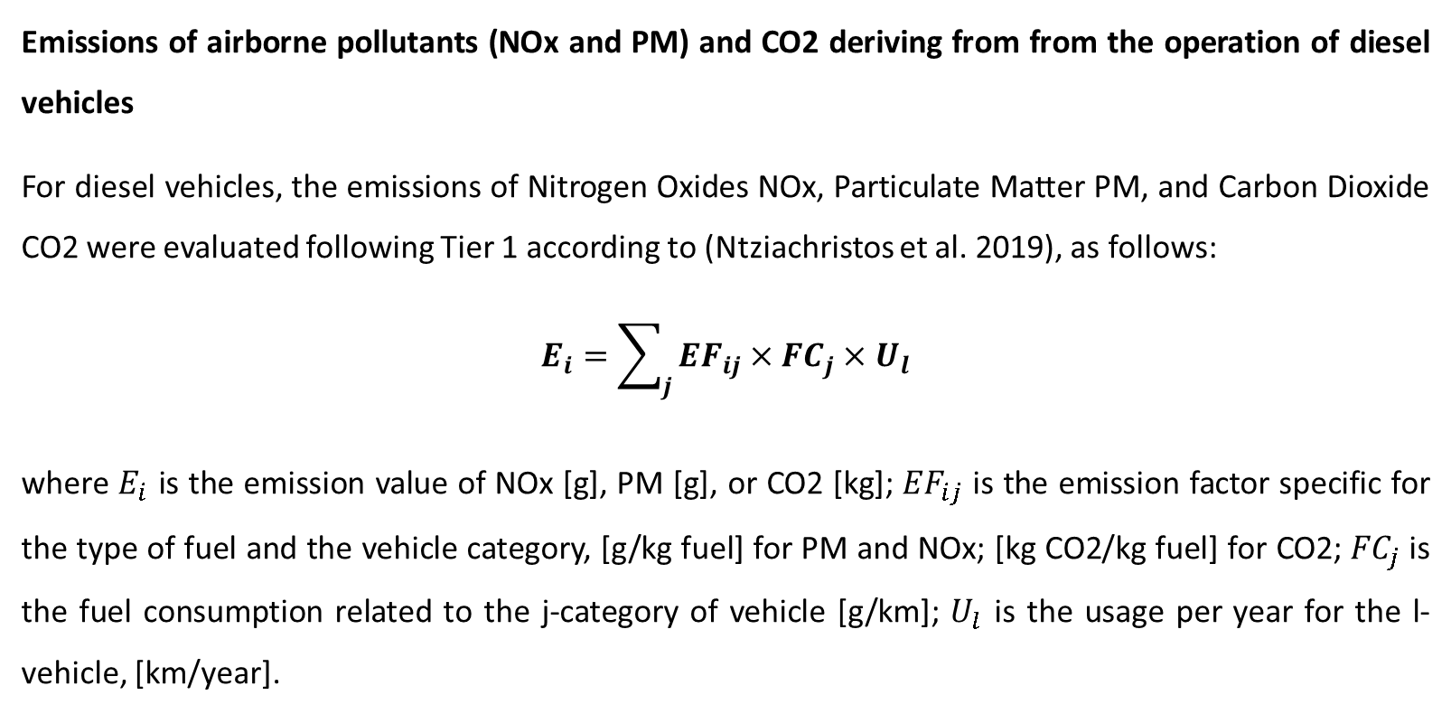
Annex: Example of environmental analysis
Emissions of airborne pollutants (NOx and PM) and CO2 deriving from from the operation of diesel vehicles
For diesel vehicles, the emissions of Nitrogen Oxides NOx, Particulate Matter PM, and Carbon Dioxide CO2 were evaluated following Tier 1 according to (Ntziachristos et al. 2019), as follows:
$$E_{i}=\sum_{j}{{EF}_{ij}}×{FC}_{j}×U_{l}$$
where $E_{i}$ is the emission value of NOx [g], PM [g], or CO2 [kg]; ${EF}_{ij}$ is the emission factor specific for the type of fuel and the vehicle category, [g/kg fuel] for PM and NOx; [kg CO2/kg fuel] for CO2; ${FC}_{j}$ is the fuel consumption related to the j-category of vehicle [g/km]; $U_{l}$ is the usage per year for the l-vehicle, [km/year].

Slide 51
Annex: Example of environmental analysis- Inputs data
-Emission factors
Category | Fuel | Airborne pollutants including CO2 | Unit of emisison factor | Emission factor
Passenger car | Diesel | NOx | [g/kg fuel] | 12.96
Passenger car | Diesel | PM | [g/kg fuel] | 1.10
Passenger car | Diesel | CO2 | [kg/kg fuel] | 3.169
Light commercial vehicles | Diesel | NOx | g/kg fuel | 14.91
Light commercial vehicles | Diesel | PM | g/kg fuel | 1.52
Light commercial vehicles | Diesel | CO2 | kg CO2/kg fuel | 3.169

Slide 52
Annex: Example of environmental analysis- Inputs data
-Technical specifications required
Type of vehicle | Model | Manufacturer | Engine power [kW] | Range* [km] | Battery capacity* [Wh] | Utilization each unit [km/year]
Electrical scooter | e.g. Model1 | e.g. Manufacturer1 | e.g. 0.3 | e.g. 45 | e.g. 473.6 | e.g. 2,000
Electrical bicyle | e.g. Model2 | e.g. Manufacturer2 | e.g. 0.25 | e.g. 70 | e.g. 360 | e.g. 3,000
Electrical pick-up vehicle | e.g. Model3 | e.g. Manufacturer3 | e.g. 10 | e.g. 201 | e.g. 19200 | e.g. 10,000
Electrical pick-up vehicle | e.g. Model4 | e.g. Manufacturer4 | e.g. 5 | e.g. 135 | e.g. 14400 | e.g. 15,000

Slide 53
Annex: Example of environmental analysis- Outputs

Slide 54




Marche Polytechnic University
Prof. Giorgio Passerini
via Brecce Bianche, Ancona, Italy
g.passerini@univpm.it
+39 071 220 4759
https://www.italy-croatia.eu/web/adrigreen

