Slide 1

New solutions for the removal and recycling of marine litter: the H2020-MAELSTROM project
CNR-ISMAR | Francesca De Pascalis
High level event A CLEAN ADRIATIC SEA FOR FUTURE GENERATIONS | online | 16 June 2021

Slide 2



H2020 MAELSTROM
Smart technology for Marine Litter susTainable
RemOval and Management
14 PARTNERS
8 EUROPEAN COUNTRIES
CNR (IT) COORDINATOR
EU contribution granted - 5,988,295.63 € (87%)
Project start - 01/01/2021
Project end 31/12/2024
Duration - 48 months
UNITED
KINGDOM
DANEMARK
NETHERLANDS
FRANCE
ITALY
PORTUGAL
SPAIN
MALTA

Slide 3
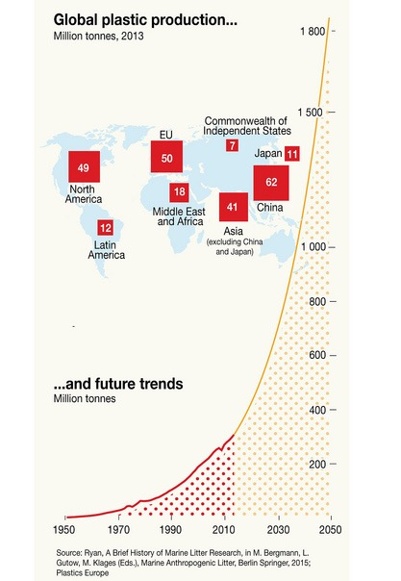
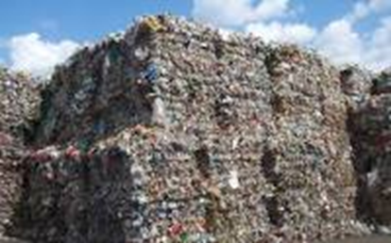
BACKGROUND:
THE MARINE LITTER ISSUE
In 2018, world plastics production totaled around 359 million metric tons
GLOBAL PLASTIC PRODUCTION & FUTURE TRENDS
In 2016, 27,1 million tons of plastic waste were reclaimed in EU with a recycling rate of 31%**
31.1 % Recycled*
37% outside EU
63% inside EU
Cartographer: Maphoto/Riccardo Pravettoni
*Sources: PlasticsEurope report 2018
**PlasticsEurope report 2018

Slide 4
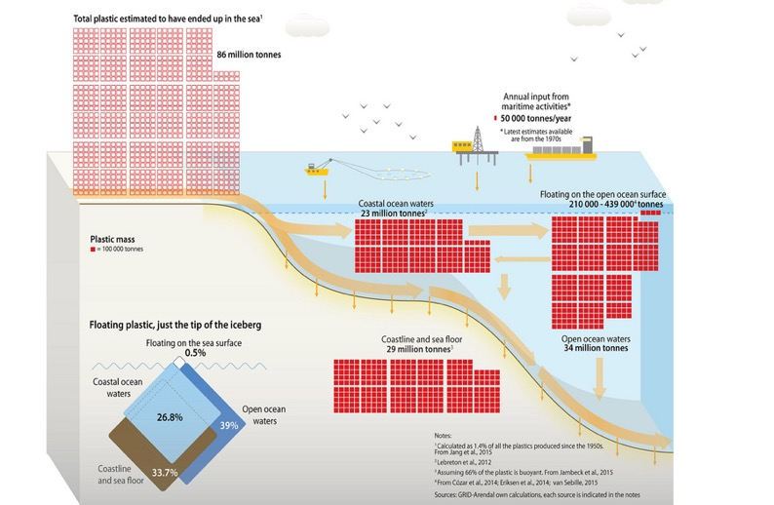
BACKGROUND:
THE MARINE LITTER ISSUE
HOW MUCH PLASTIC IS ESTIMATED TO BE IN THE OCEANS AND WHERE IT MAY BE
In 2010, from 32 to 86 MBOE (barrel oil equivalent) flowed into the sea
an equivalent of 2 to 5 Billion USD value*
Source: UNEP and GRID-Arendal, 2018. Marine Litter Vital Graphics. United Nations Environment Programme and GRID-Arendal.
Cartographer: Maphoto/Riccardo Pravettoni
*Jambeck, Jenna R., et al. "Plastic waste inputs from land into the ocean." Science 347.6223 (2015): 768-771.

Slide 5
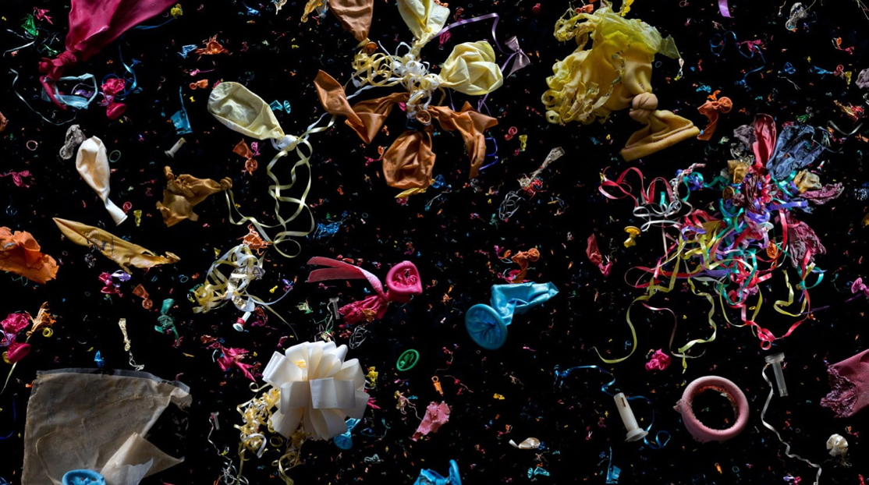
photo © mandy baker

Slide 6
SOCIOECONOMIC IMPLICATIONS OF ML
photo © mandy baker
Impacting negatively vital economic sectors:
Tourism
Fisheries
Aquaculture
Navigation
Bringing losses to:
Individuals
Enterprises
Communities

Slide 7
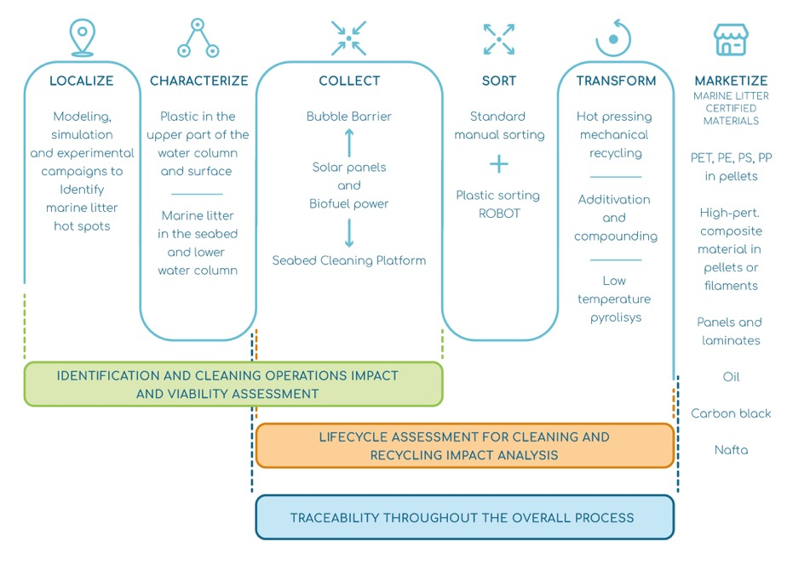
MAELSTROM CONCEPT

Slide 8
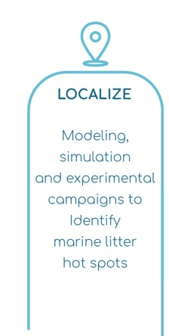
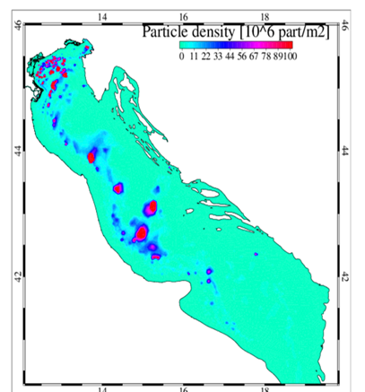
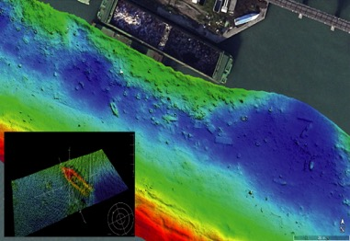
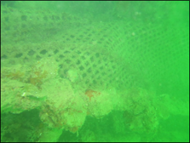
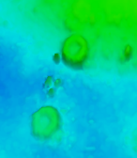
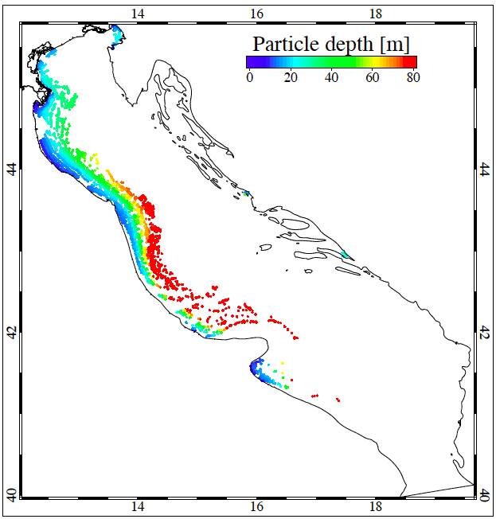
MAELSTROM PILLAR 1: MARINE BIOLOGY
Venice
Pula
Zadar
Split
Pescara
Dubrovink
Bari

Slide 10
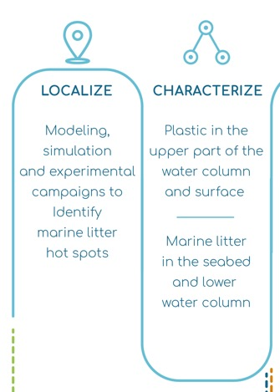

MAELSTROM PILLAR 1: MARINE BIOLOGY
MAELSTROM will set out a scientifically sound and multidisciplinary approach (Integrated Assessment Approach) to:
assess the condition of marine life on cleaning areas before and after the cleaning
evaluate the effectiveness and impact of the innovative removal technologies on the marine ecosystems and local economies

Slide 11
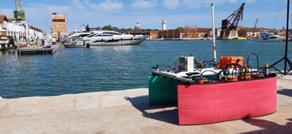


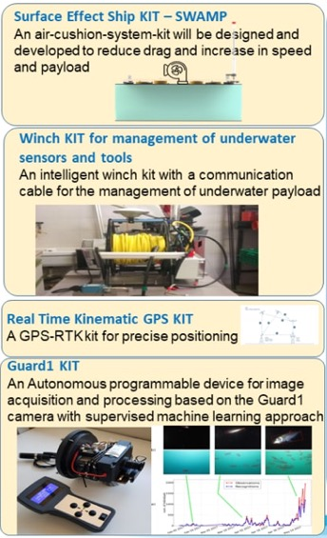
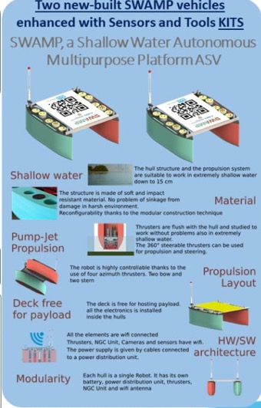
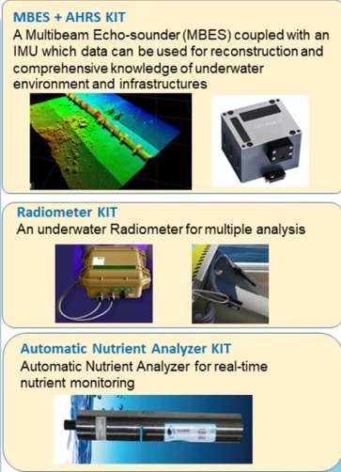
MAELSTROM PILLAR 1: MARINE BIOLOGY
Collaboration
ASV SWAMP
Courtesy of Angelo Odetti (CNR-INM) and Simone Marini (CNR-ISMAR)

Slide 12
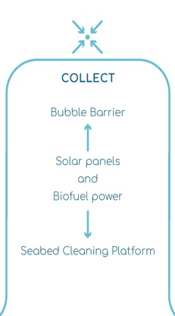
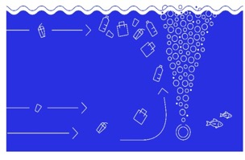


MAELSTROM PILLAR 2: MARINE LITTER REMOVAL TECHNOLOGY
PORTO (PT) DEMO SITE
GREAT BUBBLE BARRIER

Slide 13
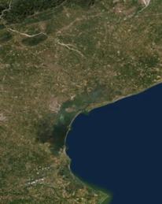
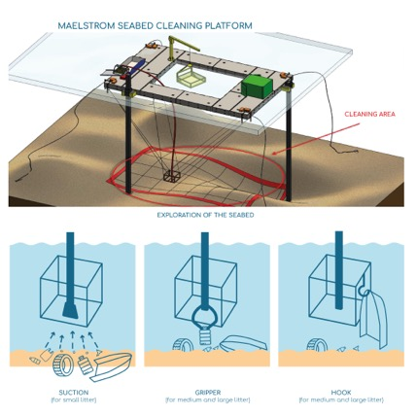

MAELSTROM PILLAR 2: MARINE LITTER REMOVAL TECHNOLOGY
VENICE
DEMO
SITE (IT)
CABLE-BASED ROBOTIC PLATFORM

Slide 14
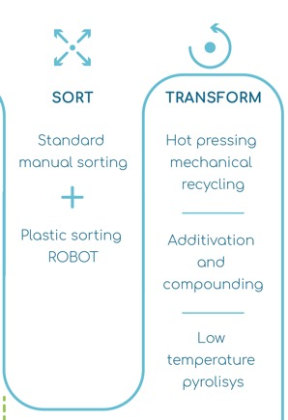
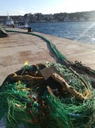
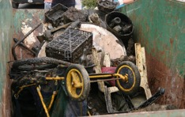
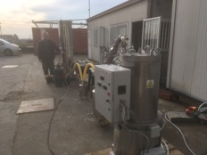
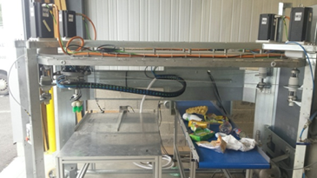
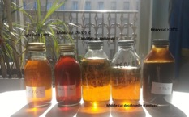
MAELSTROM PILLAR 3: CIRCULAR ECONOMY
DIFFERENT TYPES
OF RECYCLING
SORTING-ROBOT

Slide 15
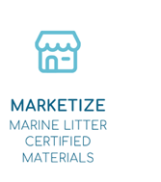
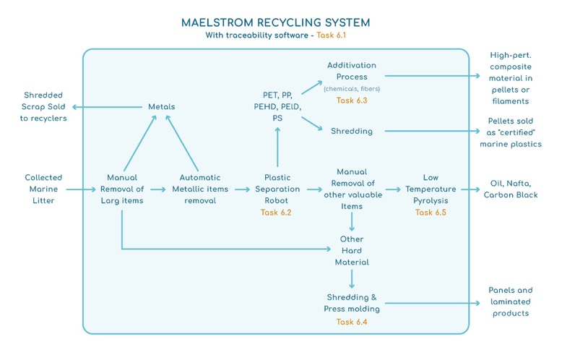
MAELSTROM PILLAR 3: CIRCULAR ECONOMY

Slide 16
MAELSTROM ‘4TH PILLAR’
COMMUNICATION, DISSEMINATION and NETWORKING
Notes:
Life-sized recycled plastic whale installation
3 international workshops in Venice together with the H2020 IN-NO PLASTICS
Clean-up campaigns in Venice, Porto and San Sebastian
Two side-events to demonstrate the removal technologies (Porto- Business2Sea, Venice-International Venice Boat Show)
GO GLOCAL – think global, act locally! engage with schools , companies and associations from local territories

Slide 17
Possible MARELESS- MAELSTROM
collaborations and synergies
Venice cleaning demo in 2022
Cleaning Platform ready in June 2022
2 months of cleaning activities in 2 locations inside and outside the Venice lagoon
1 Pre cleaning monitoring of the seabed status
3 post cleaning monitoring (every 6 months)
Possible collaboration agreement on
Data Exchange
Identification of the best locations for MAELSTROM cleaning activities
Synergies on the monitoring activities

Slide 18
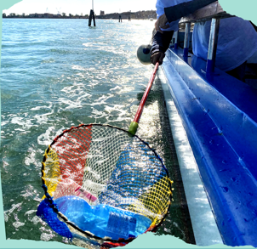


Thank you for you attention
Fantina Madricardo MAELSTROM Project coordinator
Francesca De Pascalis InnovaMare CNR-ISMAR Contact point
fantina.madricardo@cnr.ismar.it
francesca.depascalis@cnr.ismar.it
www.maelstrom-h2020.eu
www.italy-croatia.eu/innovamare

